Slide 1
Changes in Forensic Services
Jeffrey Waldman, MD FRCPC, Forensic Psychiatrist
Medical Director Forensic Services
Ken MacKenzie, MSW, BSW,BA WRHA Director Crisis & Forensic Services
Notes:
GRAND ROUNDS presentation – U of M Department of Psychiatry
Jan 19, 2016

Slide 2
Prior to March 2013
No data
No standardized processes
No program evaluation other than Mental Health Court program evaluation by contracted researcher.

Slide 3
A Framework to Understand Diversion of the Mentally Ill out of the Criminal Justice System (Menetz & Griffin 2006)
Note: Retrieved from, Use of sequential intercept model as an approach to decriminalization of people with serous mental illness, Psychiatric Service (2006), 57, 4, 544-549), downloaded October 12, 2013

Slide 5
Forensic Services

Slide 6
The Demand on PX3

Slide 7
Demand-Number of Court Ordered Assessments

Slide 8
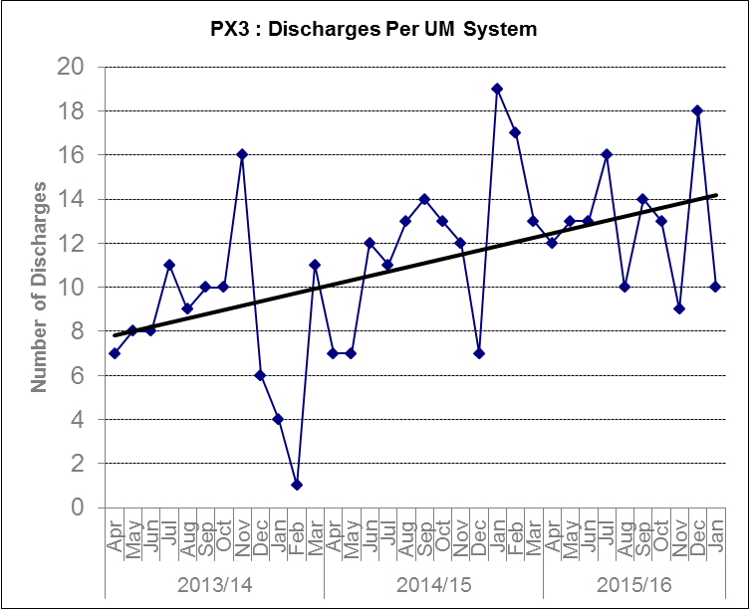
Number of discharges- PX3

Slide 9
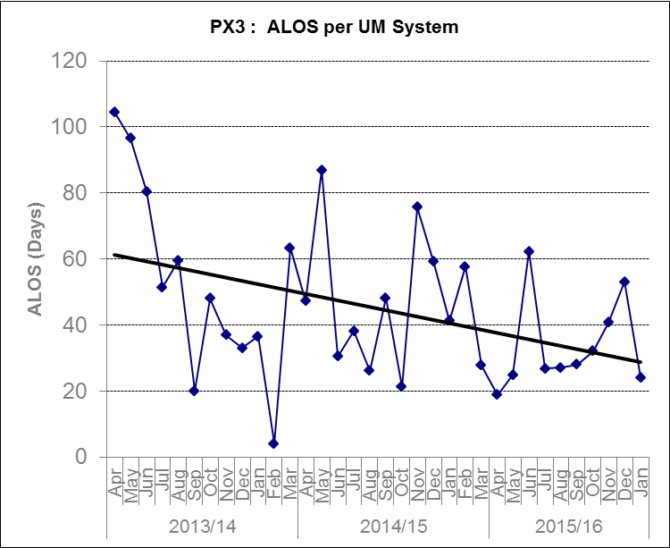
Length of Stay- PX3

Slide 10
Fitness Clinic

Slide 11
Other Program Evaluation
Expansion of the National Trajectory project (awaiting funding)
Provincial replication of the National Trajectory Project (awaiting funding)
Daily Dispensing (MPAN Funding, awaiting ethics)
Fitness Clinic (MPAN funding, awaiting ethics)
Ongoing evaluation of MHC

Slide 12
If time-other cool initiatives
Standardized operating procedures
Standardization of assessment reports
AIS and HARM
DBT
Transition away from using Corrections officers
Educational sessions for stakeholders
More to come…

